Slide 1
Mr. Flinchum’s Classroom Expectations

Slide 2
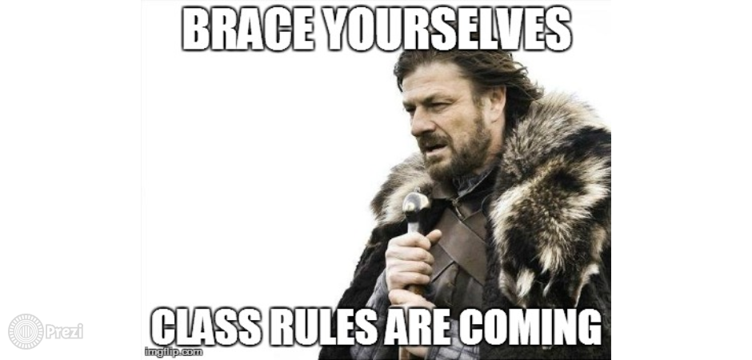

Slide 3
EVERY DAY:
Writing Utensil
Paper or Notebook
Good Attitude

Slide 4
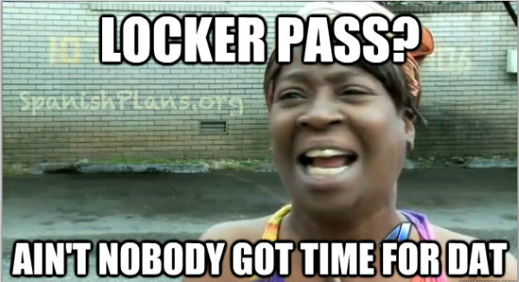
Forgot something?
Adapt and Overcome:
* Borrow
Paper Drawer

Slide 5
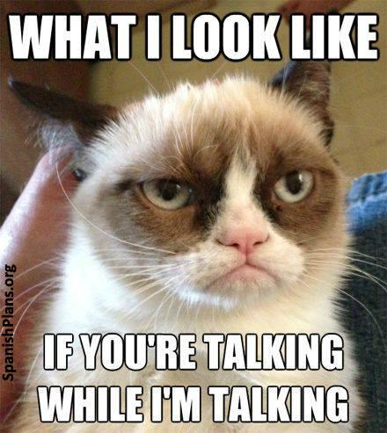
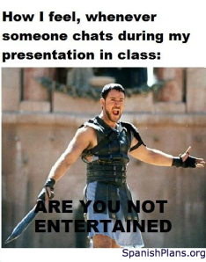

Slide 6
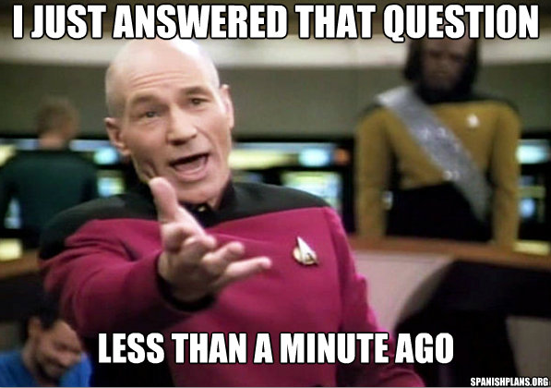
Because when you do, this is what happens

Slide 7
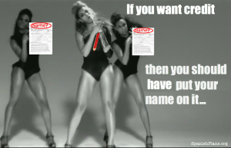

Slide 8
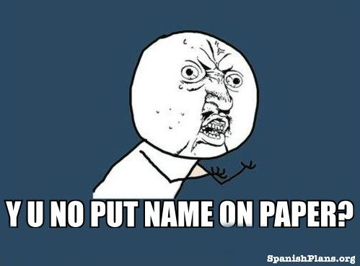
Type or write your name at the top of all documents.

Slide 9
This is how your paper should look
First Name Last Name
Subject
Teacher’s Name
Date
Assignment Title

Slide 10
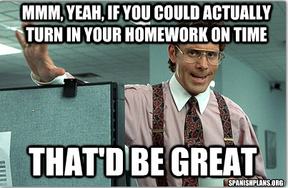
In order to get credit for your assignments they must be turned in
Every day an assignment is late = 5 points off
Emergency? Email me or call

Slide 11
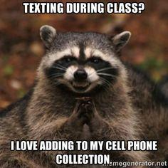
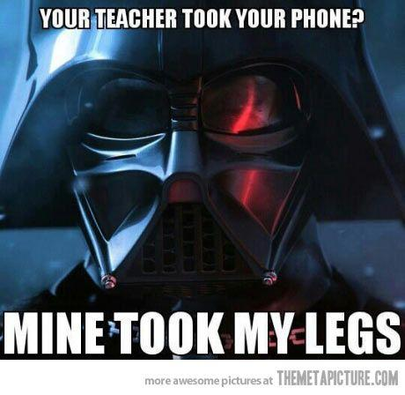

Slide 12
Times You Can Use Technology
Can use headphones only during active independent work
Cell phone use IS NOT ALLOWED in class

Slide 13
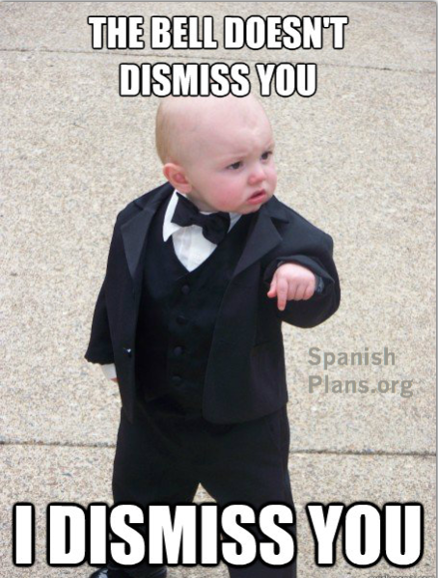
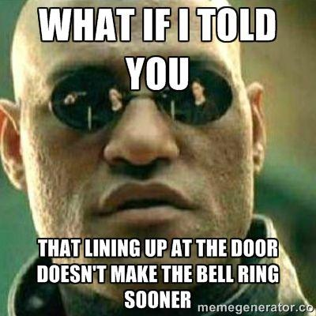

Slide 14
Dismissing from class
I do not wish to hold you in class after the bell has rung
If we stay focused on the work or activity we are doing, I will allow you plenty of time to get your things together to leave
You must be responsible for your area; having a mess could result in you staying after class

Slide 15
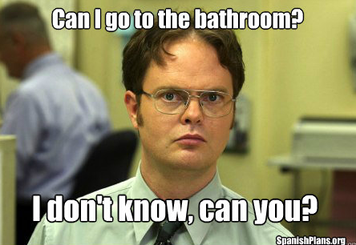
Policy for Leaving During Class Time
Wait for Security
Once available, take pass and use 1 of 3 bathroom passes

Slide 16
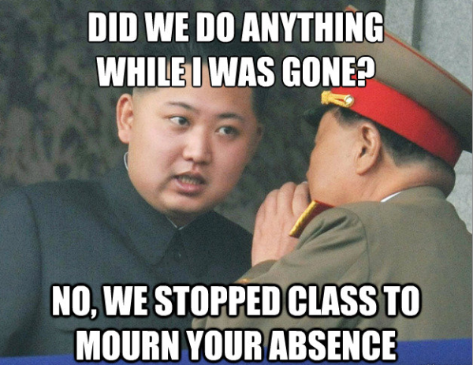
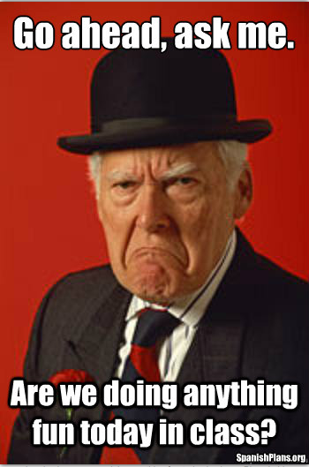
Check the Assignment Board
Ask a trustworthy classmate
Or wait until a break and ask me any questions

Slide 17
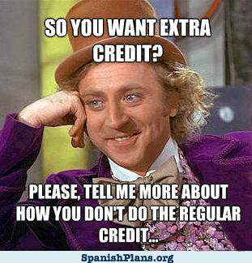
You must do the work assigned FIRST!!!!

Slide 18
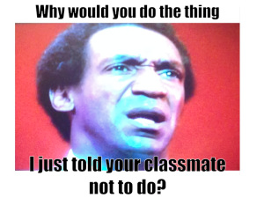
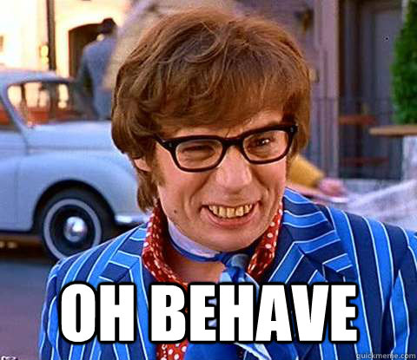
Student Behavior

Slide 19
